Slide 1
Cloud Concepts

Slide 2
On Premise
CDs/Pendrive to install software on your system.
Software lies within your private network.
Adobe Photoshop CS6, Illustrator, Old Games.

Slide 3
Cloud
The cloud is a distributed collection of servers that host software and infrastructure.
Cloud enables Cloud Computing.

Slide 4
Cloud Computing
Cloud computing is the on-demand delivery of IT resources over the Internet with pay-as-you-go pricing.
IT resources such as computing power, storage, and databases, are provided on an as-needed basis from a cloud provider.

Slide 5
Cloud Provider
Maintains the Cloud Infrastructure and Resources.
Provides Cloud Computing Services like servers, storage, db, networking, software, analytics, etc.,
Eg: AWS, OCI, GCP, Azure, IBM, etc.,

Slide 6
Cloud Computing Services Types
IaaS – Infrastructure as a Service
PaaS – Platform as a Service
SaaS – Software as a Service

Slide 7



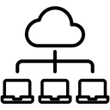

IaaS
Cloud Provider offers
compute instance/servers
Console
network
Storage/DB
User develops the software
User creates compute service,
Storage, network
User deploys the software

Slide 8
IaaS
Cloud Providers: AWS, Azure, GCP, IBM Cloud, OCI

Slide 9
PaaS
Cloud Provider
Console
User develops the software
Pushes the software to the cloud

Slide 10
PaaS
Heroku
AWS (Elastic Beanstalk,lambda, App Runner), Azure (App Service, Azure Functions and Azure Logic Apps).
GCP offers a range of PaaS services, including Google App Engine, Google Cloud Functions and Google Cloud run)
IBM Cloud: IBM Cloud Factory, Cloud Functions and IBM cloud Pak
Oracle Cloud Platform(OCP): Oracle Application Container Cloud, Oracle Functions and Oracle Integration Cloud.

Slide 11
SaaS
Cloud Provider offers
Console
User uses the software

Slide 12
SaaS
Cloud CRM Applications (Salesforce), Cloud based file storage (Drop box), Slack (cloud based messaging), Cloud based video conferencing (Zoom),
Entertainment: Netflix, YouTube, Instagram, etc.,

Slide 13
IaaS

Slide 14



Cloud Provider
Cloud Provider Console (AWS, OCI, Azure, etc.,)
Backend Server
Sign up
Customer A
Sign up
Customer B Tenancy
Customer A Tenancy
Customer B

Slide 15

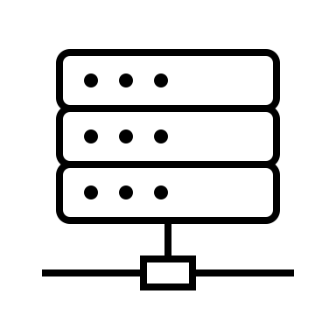
Cloud Provider
Cloud Provider Console (AWS, OCI, Azure, etc.,)
Backend Server
Create
Create Server Instance
Customer A
Create DB
Create
Customer B Tenancy
Customer A
Tenancy
Customer B

Slide 16
Deploying an Application

Slide 17
Cloud Provider
Cloud Provider Console (AWS, OCI, Azure, etc.,)
Backend Server
Create
Create Compute Instance
Customer A
Customer A Tenancy

Slide 18
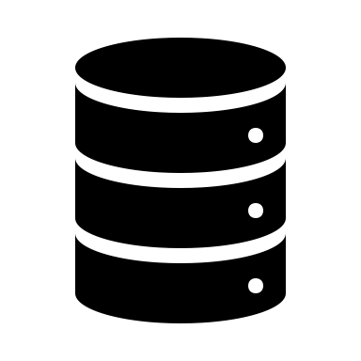
Cloud Provider
Cloud Provider Console (AWS, OCI, Azure, etc.,)
Backend Server
Create
Create Database
Customer A
Customer A Tenancy

Slide 19
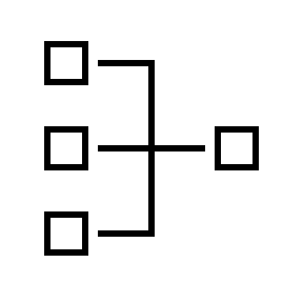
Cloud Provider
Cloud Provider Console (AWS, OCI, Azure, etc.,)
Backend Server
Create
Create Network
Customer A
Customer A Tenancy

Slide 20
Cloud Provider
Cloud Provider Console (AWS, OCI, Azure, etc.,)
Backend Server
Deploy
Deploy Application
Customer A
Customer A Tenancy

Slide 21
IaaS
You developed the application
You clicked Create button in Cloud Provider Console
You manage the application.
You pay only for what you used.
You don’t pay for their physical machines.
You can make your application available globally within a single click
You can manage customer traffic by scaling your instances with click of a button
Cloud Provider created your infrastructure
Cloud Provider owns the physical infrastructure.
Cloud Provider manages the infrastructure

Slide 22
PaaS
You develop application
You push the application to Cloud Provider console
Cloud Provider creates Infrastructure by itself
Manages application performance

